Slide 1
Sulphur River Backwater Habitat Modeling Results
Danny Allen
Wildlife Biologist
CESWF-PEC-TN
15 November 2016

Slide 2
Sulphur River Ecological Functions Model Development Overview
Develop ecological relationships between bottomland communities and hydrology
Model ecological relationships with historic gauge data and period of record with HEC-EFM
Identify flow/stage metrics for bottomland communities for existing and each proposed pool elevation
Validate model utilizing GSRC and TPWD spatial vegetation data
Model spatial extent of bottomland communities with RAS-Mapper

Slide 3
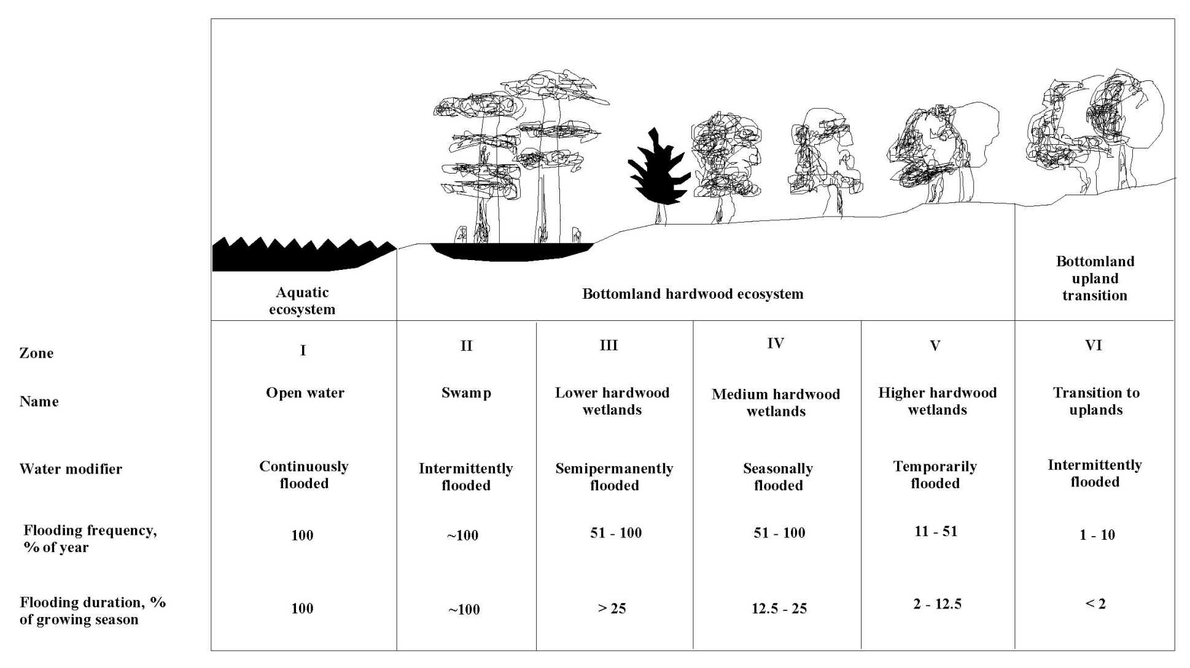
Ecological/Hydrological Relationships
Notes:
Zone 1 – Open Water – Flooded 99%
Zone 2 – Bald Cypress/Tupelo Swamp – Flooded 60%/180 days
Zone 3 – Bottomland Hardwood – Flooded 40%/60 days (Bald Cypress, Planertree, Overcup Oak, Sweetgum)
Zone 4 – Seasonally Flooded Forest – Flooded 12.5%/30 days (Willow Oak, Water Oak, Overcup Oak, Sweetgum)
Zone 5 – Temporarily Flooded Forest – Flooded 2%/5 days (Water Oak, Sweetgum, Loblolly Pine, Cedar Elm)
Zone 6 – Upland – Flooded 1% (Sugarberry, Sweetgum, Water Oak, White Oak)
Taken from “Bottomland Hardwood Types in Cypress-Caddo Project Area

Slide 4
EFM Relationships
Floodplain Zone | Flood Frequency
Open Water | 90%
Swamp | 60%
Bottomland Hardwood | 40%
Seasonally Flooded | 12.5%
Temporarily Flooded | 2%
Upland | 1%

Slide 5
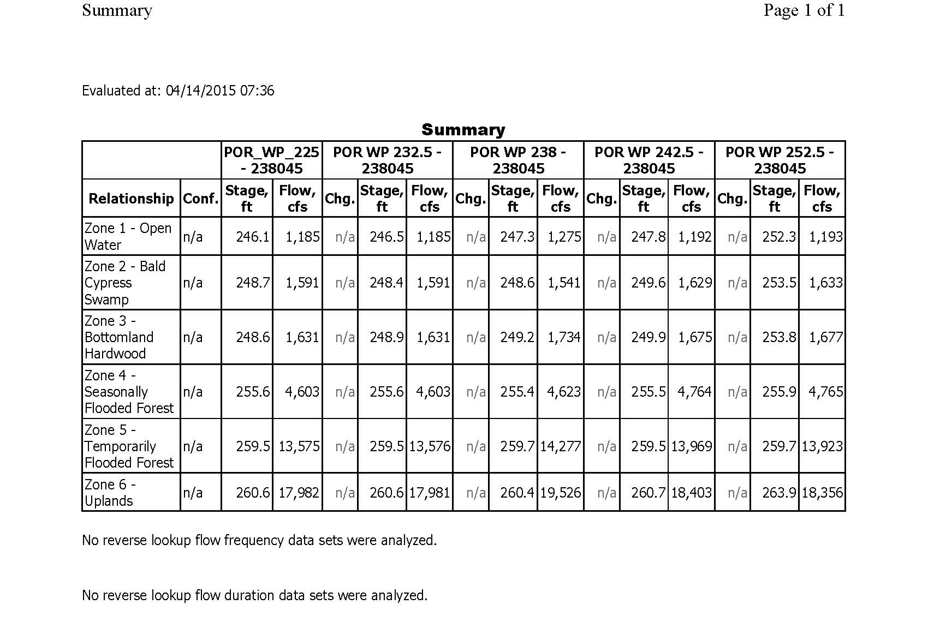
EFM Results – 225’ @ 238045

Slide 6
Sulphur Basin Segments
  White Oak Creek Wildlife Management Area (WOCWMA)
  WOCWMA to upper Wright Patman
  Wright Patman Pool

Slide 7
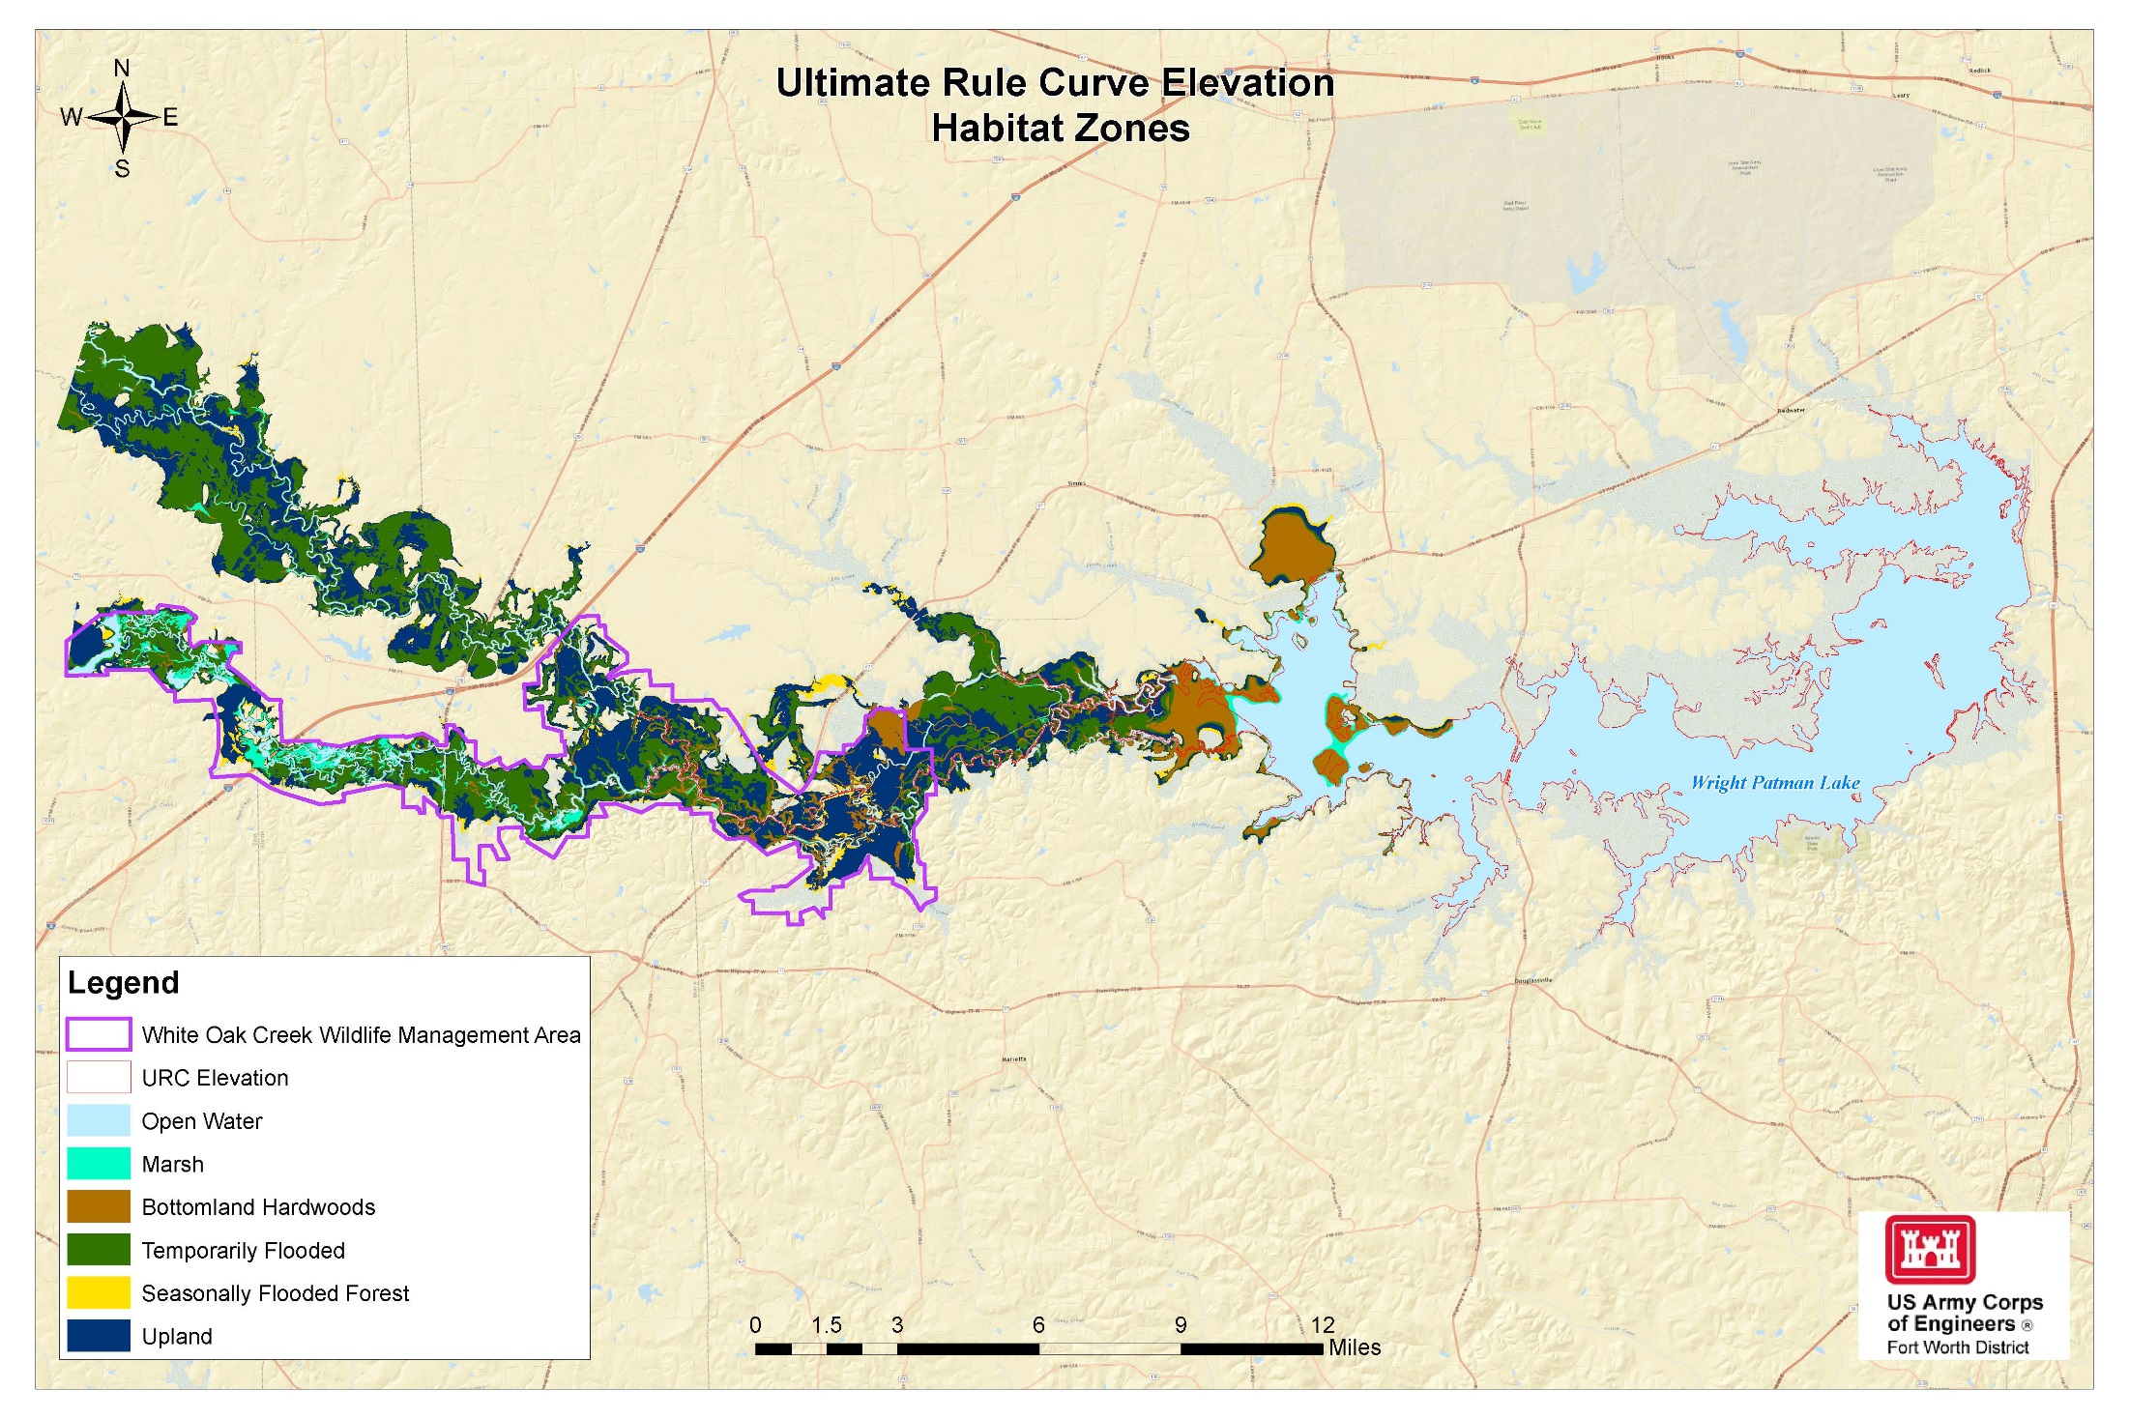

Slide 8
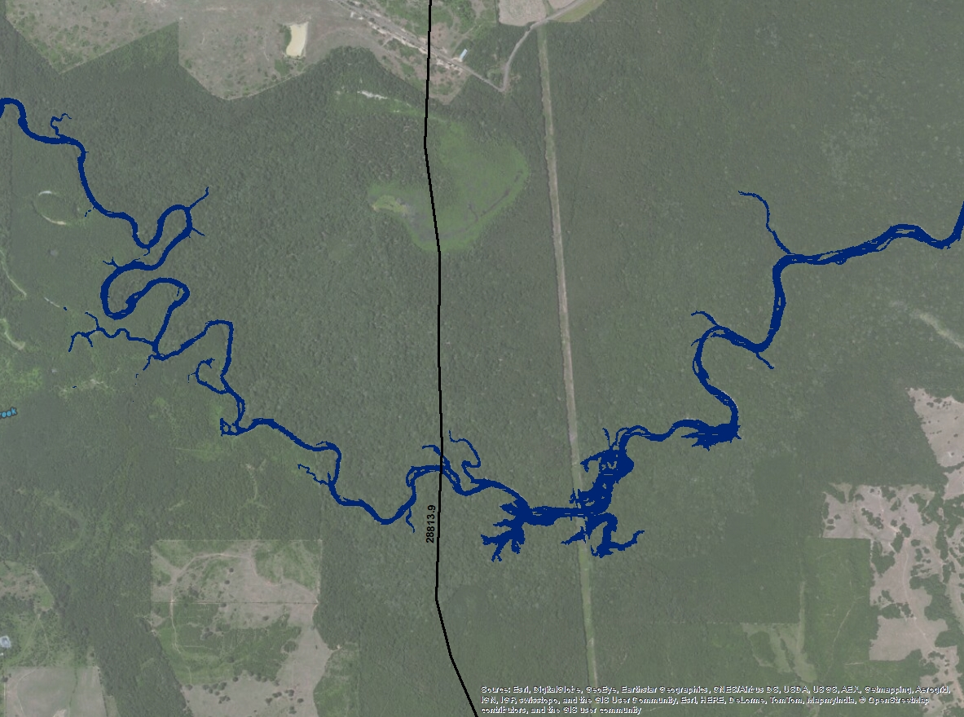
Open Water 225’ – CS 28813.9

Slide 9
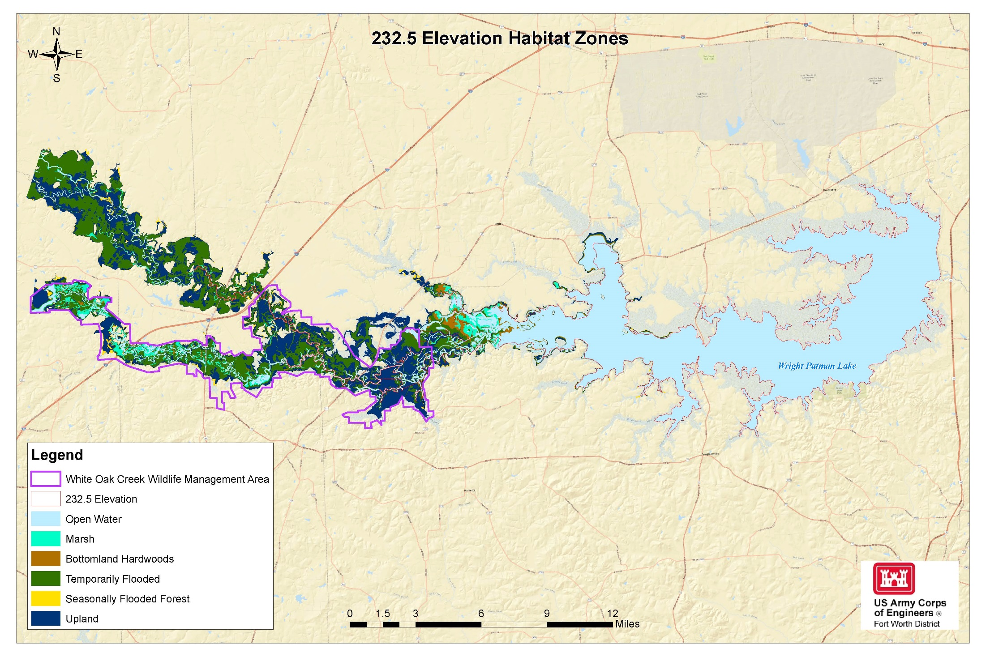

Slide 10
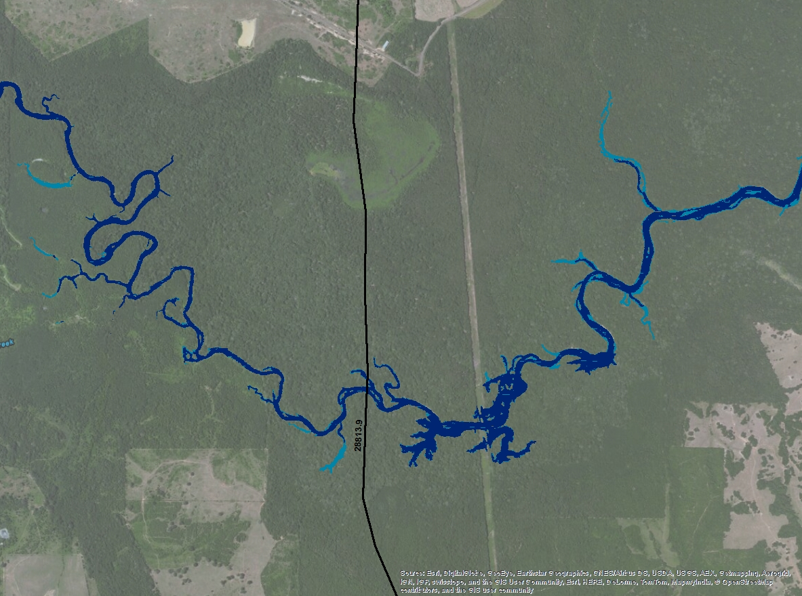
Open Water 232.5’ – CS 28813.9

Slide 11
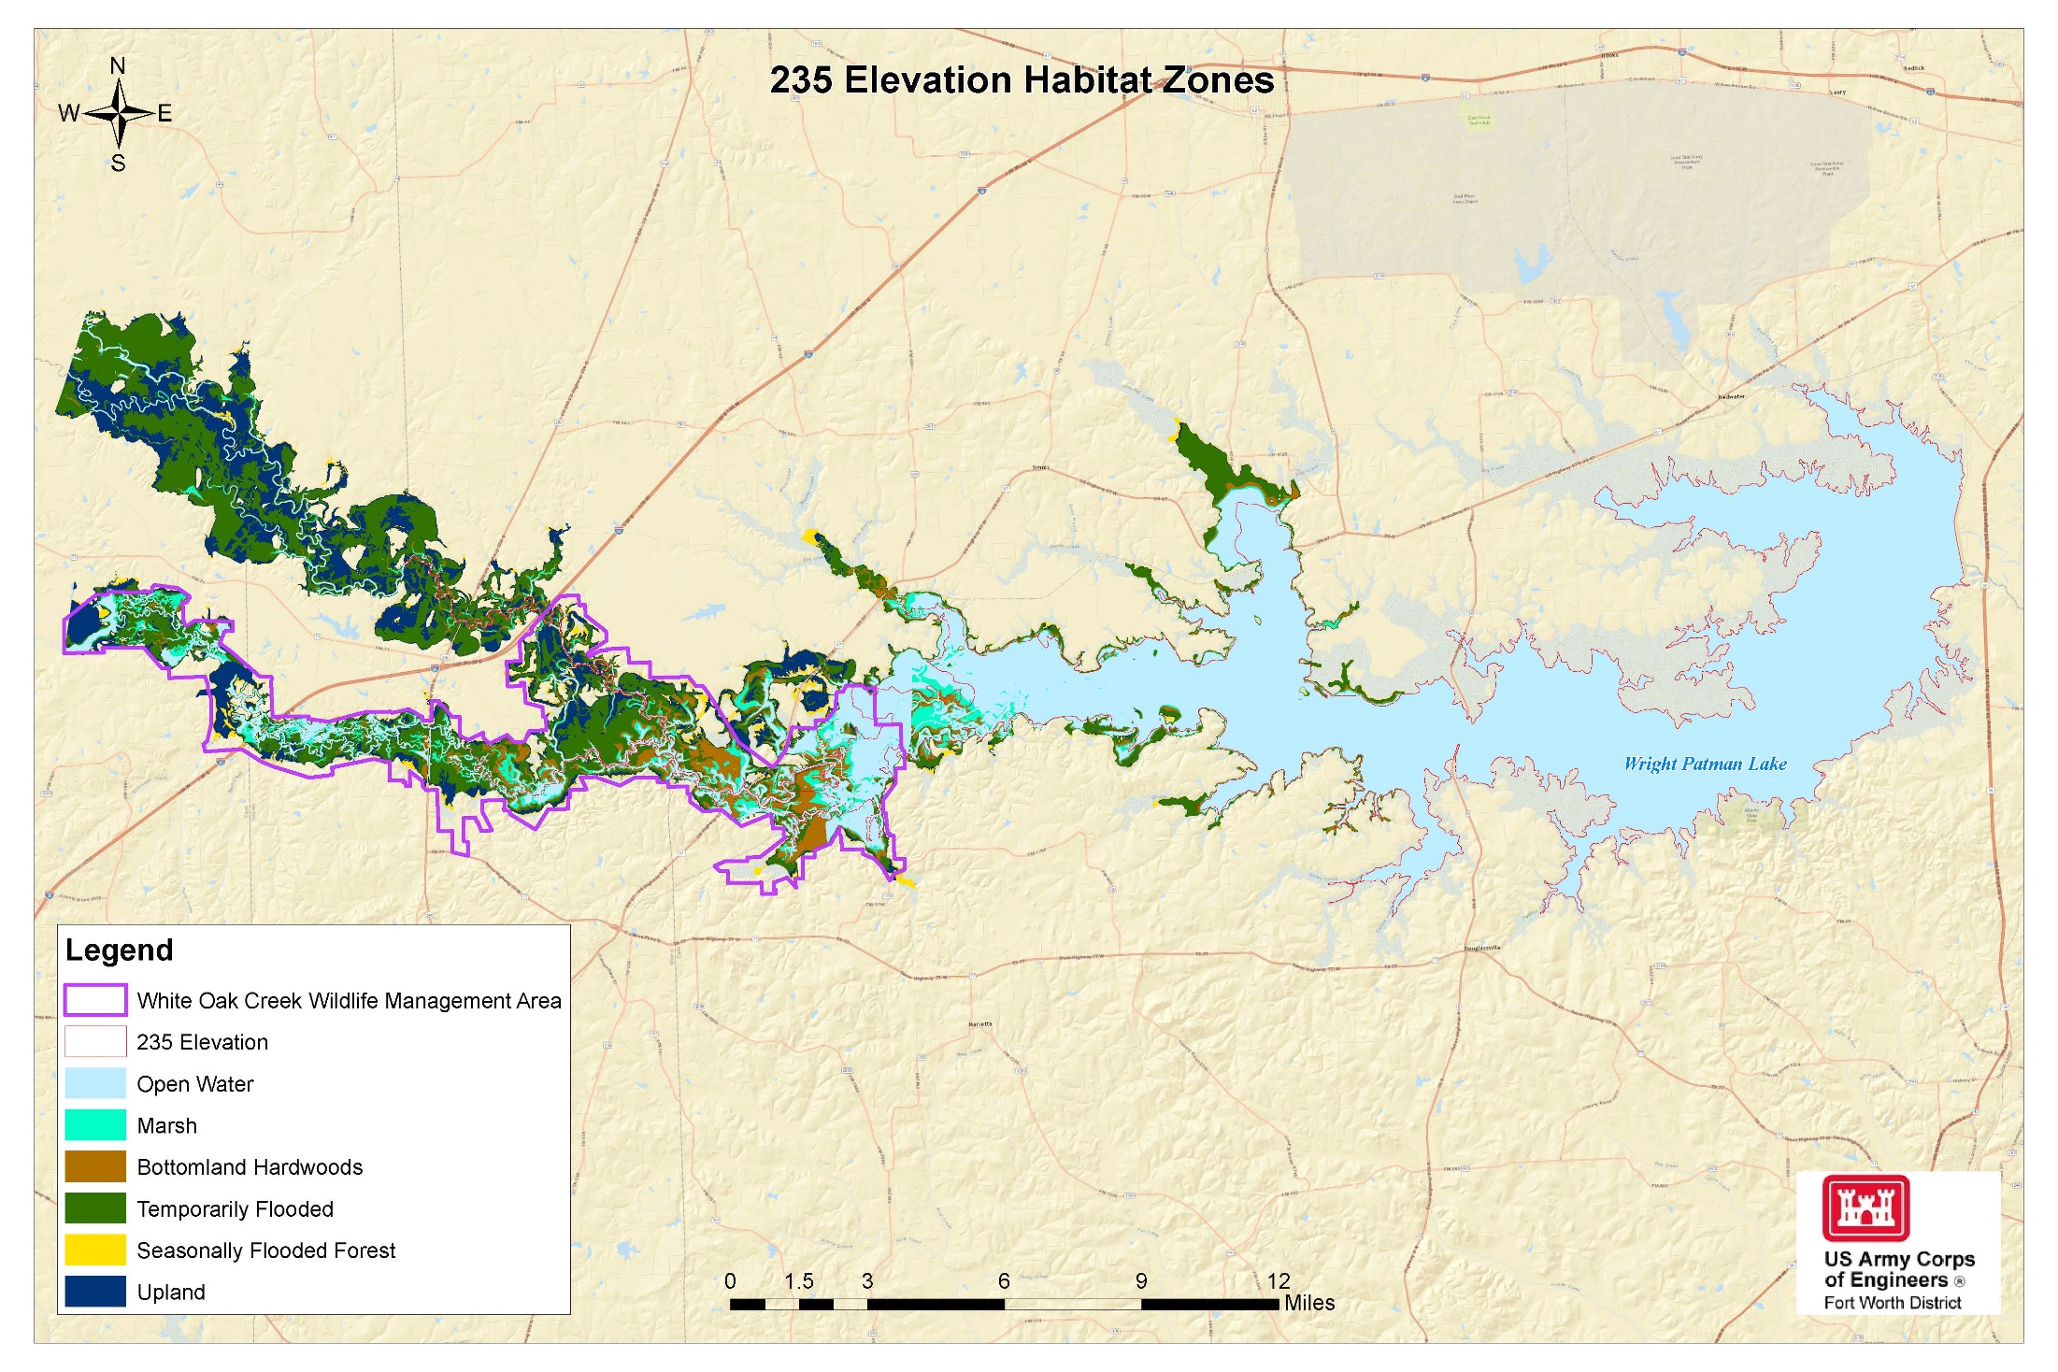

Slide 12
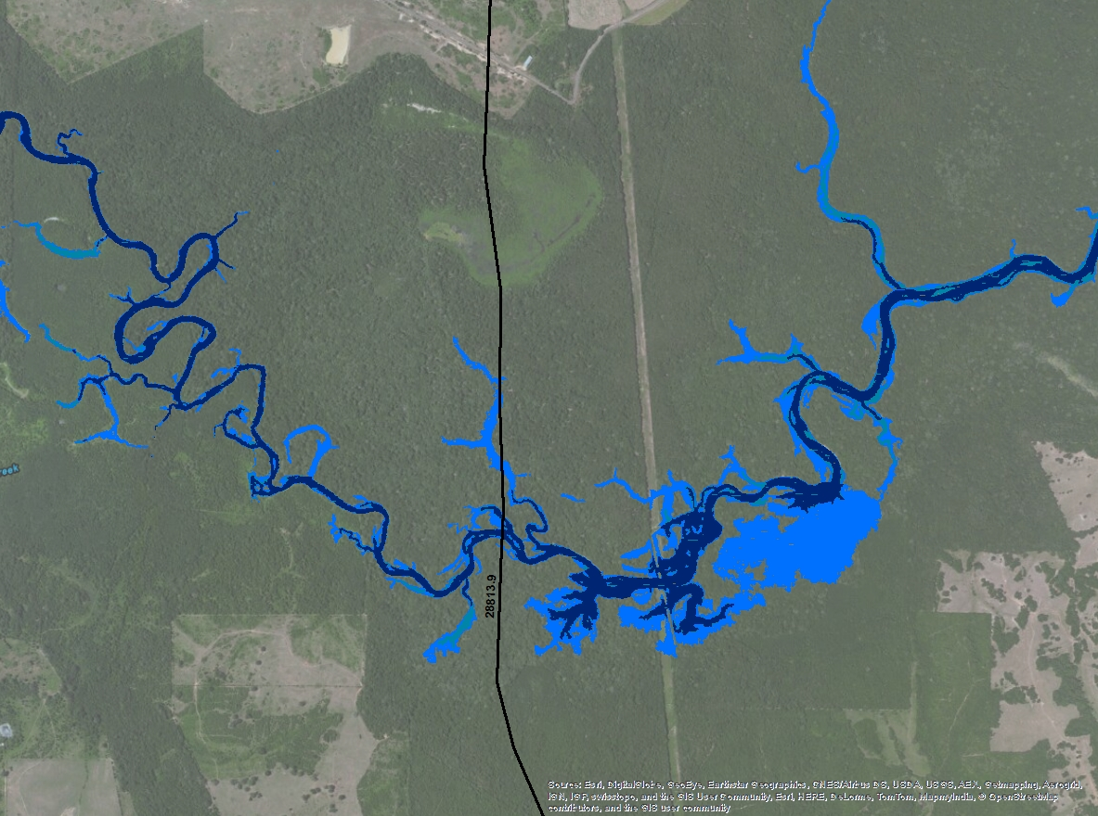
Open Water 238’ – CS 28813.9

Slide 13
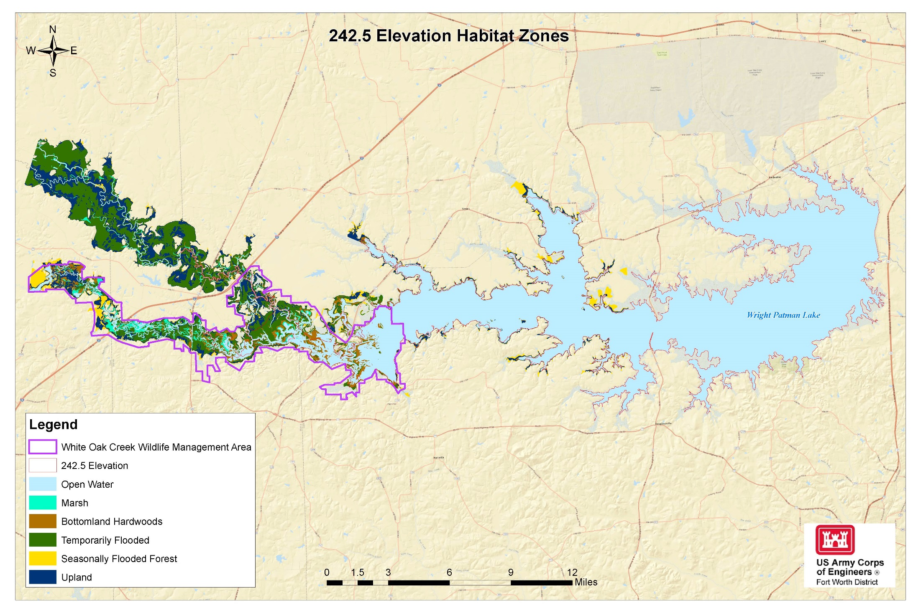

Slide 14
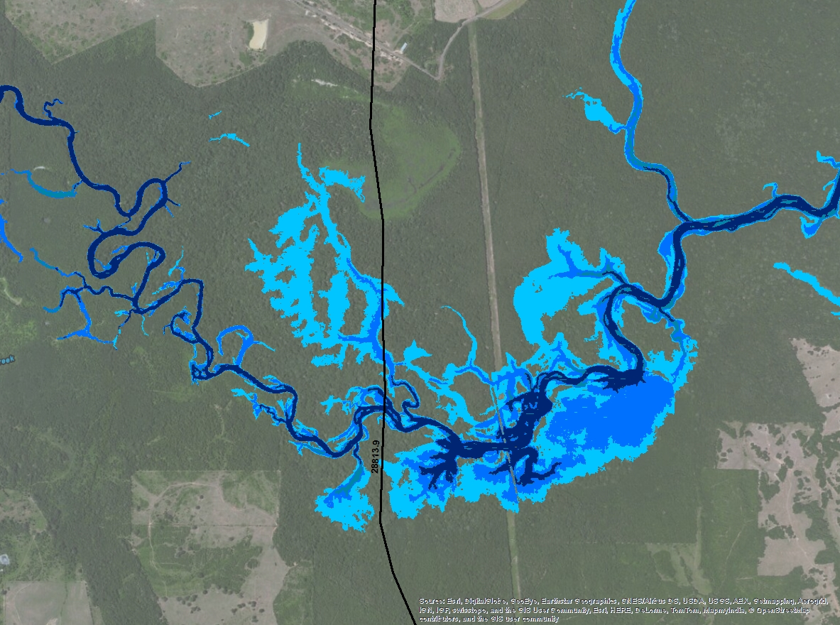
Open Water 242.5’ – CS 28813.9

Slide 15
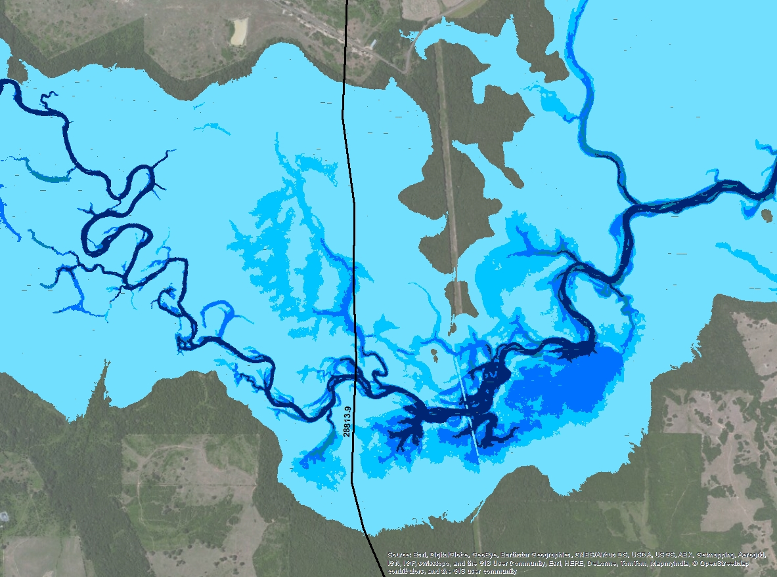
Open Water 252.5’ – CS 28813.9

Slide 16
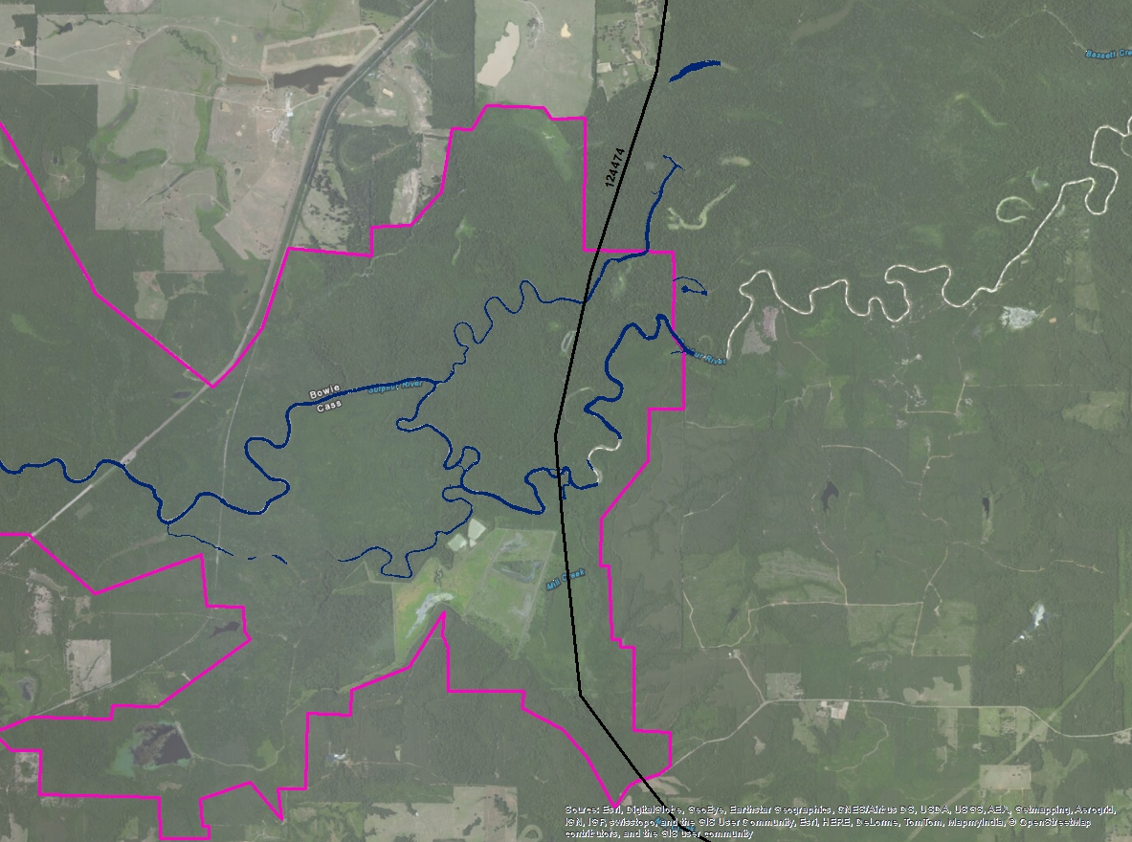
WOC East Boundary 225

Slide 17
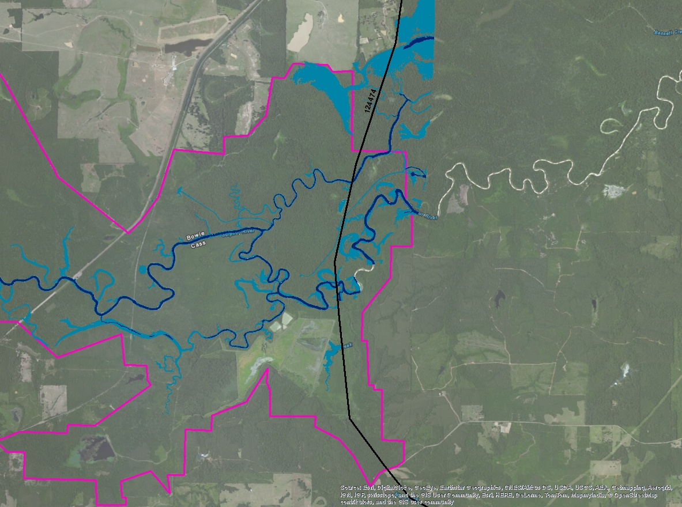
WOC East Boundary 232.5

Slide 18
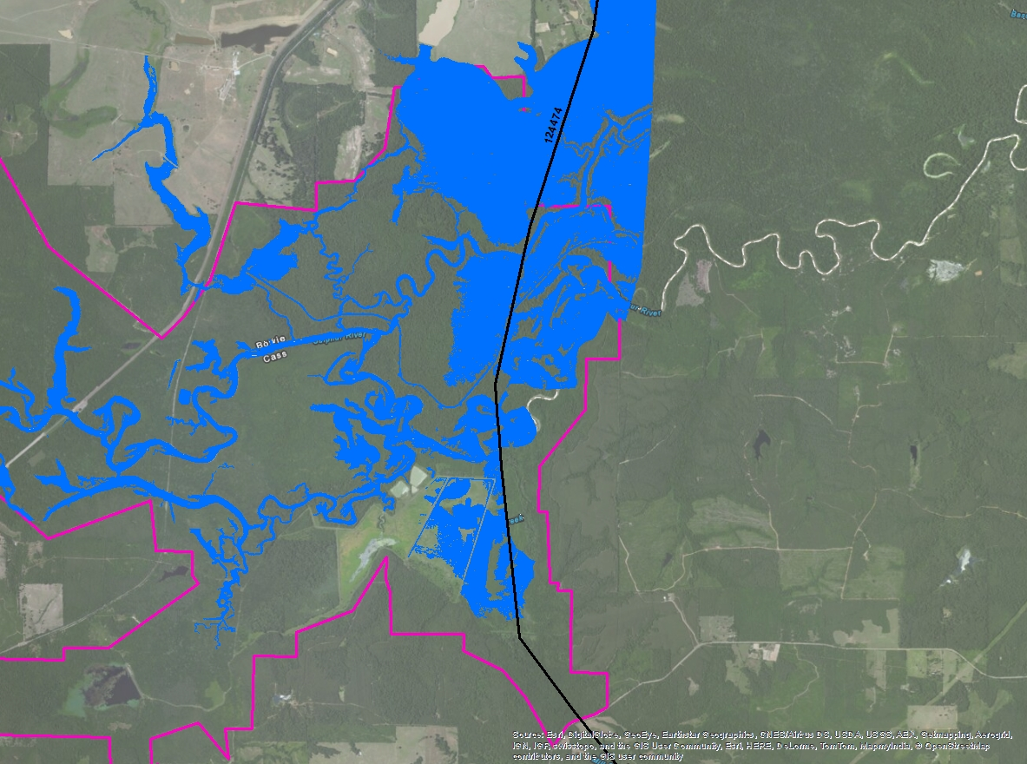
WOC East Boundary 238

Slide 19
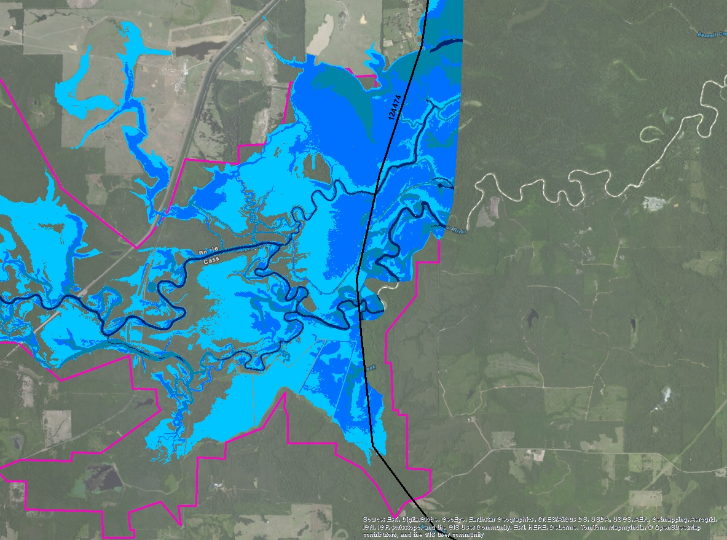
WOC East Boundary 242.5

Slide 20
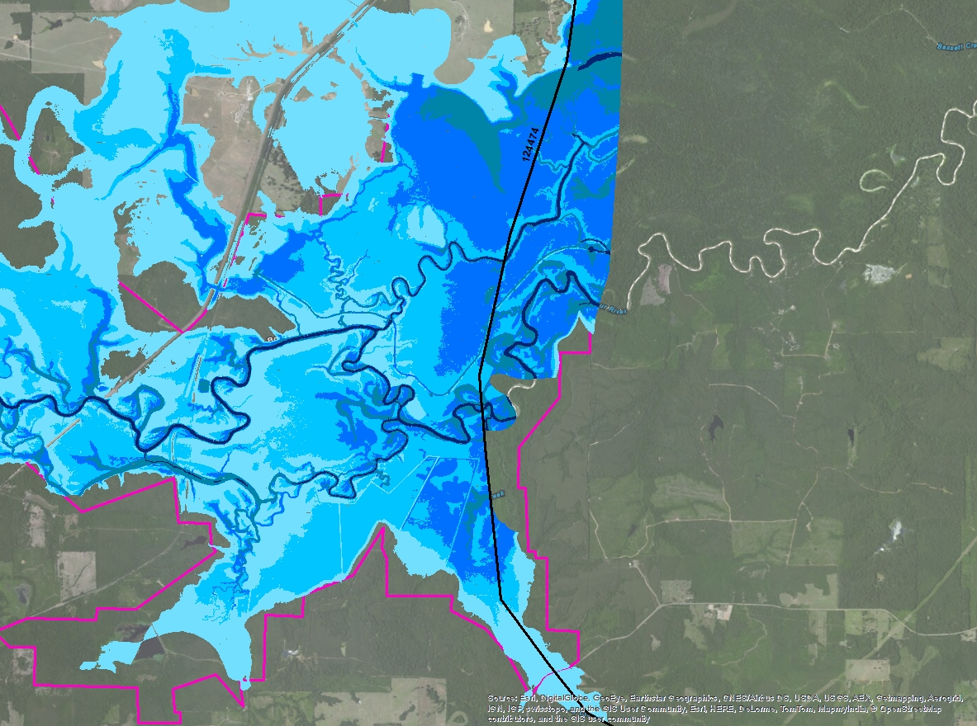
WOC East Boundary 252.5

Slide 21
Questions

